Slide 1

Regular Expressions
Miroslav Biňas
(c) 2010 - 2013
Notes:
62min (4)
tasks:
- grep nefunguje dobre pre \< (akceptuje aj znaky ako ., :, -, ...)
- grep nefunguje dobre pre \X (nefunguje vobec? :-)
=> zrejme bolo potrebne to uzatvorit do '...'

Slide 2


Regular Expressions I.
regexp is a special text string for describing a search pattern
they are complicated: ^([a-z\d\._-]+@([a-z\d-]+\.)+[a-z]{2,6})$
useful for string recognition:
user's input
forms validation
recognition of e-mail addresses, IP address, URLs, ...

Slide 3
Regular Expressions II.
support in text editors, programming languages, many tools
regexp types:
POSIX - UNIX compatible
PCRE - Perl Compatible RegExps
regexp test tools:
gui apps
online tools (https://regexr.com )
egrep (alias for grep -E)
man re_format

Slide 4
The Basics
regexp are case sensitive source: "Hello, world„
"Hello" -> "Hello, world„
"HELLO" -> "Hello, world"
to ignore case sensitive, use opt –i
"HELLO" -> "Hello, world"
every character counts
"Hello, " -> "Hello, world„
"Hello, " -> "Hello, world"
egrep --colour=always "Hello" x.txt

Slide 5
Main Metacharacters
\<KEY - words beginning with KEY
KEY\> - words ending with KEY
^ - beginning of line
$ - end of a line
\X - match special character X
escaping
. - match any single character
echo "ako Ako dko" | egrep --colour=always "\<A"
echo "ako Ako dko" | egrep --colour=always "ko\>“
echo "ako Ako dko" | egrep --colour=always ".k"
Notes:
'\<key' => keyword, keyboard
'\\' => \janko
'\.' => koniec vety.

Slide 6
RE Character Classes I.
character class or character set is enclosed inside of [ and ]
match, if any character from character class was found
order is insignificant
source: "How are you?„
"[oyu]" -> "How are you?" "[aH]." -> "How are you?" - aH a jeden znak za ním "[o][wu]" -> "How are you?" - jeden znak z prvej nasledovany jedným znakom z druhej skupiny

Slide 7
RE Character Classes II.
range of characters can be specified with [ - ]
several ranges can be specified in one expression
examples: a-z, A-Z, A-z, 0-9
notice: [a-d] is not always [abcd]
depends on locale
[a-d] can be [aBbCcDd]
[A-z] is then different to [a-Z]
source: "abcde01234567„
"[c-k2-6]"->"abcde01234567"

Slide 8
RE Character Classes III.
negation operator ^ char
source: "abcde01234567„
"[^c-k2-6]"->"abcde01234567"

Slide 9
RE Quantifiers
star '*' matches zero or more times
plus '+' matches once or more times
question mark '?' matches zero or once
source: "aabc abc bc" "a*b" -> "aabc abc bc" "a+b" -> "aabc abc bc" "a?b" -> "aabc abc bc"

Slide 10
Matching Alternatives
parenthesis () are used for
grouping (and back-referencing)
matching alternatives separated with '|'

Slide 11
Matching Alternatives Examples
dni.txt "Monday, Tuesday, Wednesday, Thursday, Friday, Saturday, Sunday" regexp: "(on|ues|rida)"
match: "Monday Tuesday Friday"
regexp: "(Mon|Tues|Fri)day"
match: "Monday Tuesday Friday"
regexp: "..(i|es|n)day"
match: "Monday Tuesday Wednesday Friday Sunday"
regexp: "...(i|es|n)day"
match: "Wednesday"

Slide 12
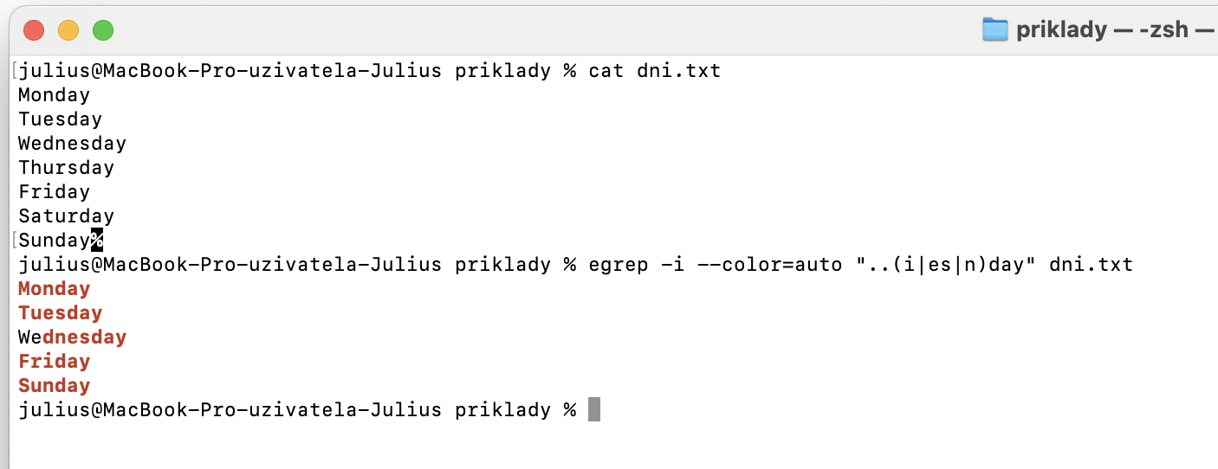
Egrep výstup

Slide 13
Character Repetition
{m} - matches exactly m times
{m,n} - matches min. m times and max. n times
{m,} - matches min. m times
{,n} - matches max. n times

Slide 14
Character Repetition Examples
source: "Regular expressions"
regexp: "s{2}"
match: "Regular expressions" regexp: "[esr]{1,3}"
match: "Regular expressions"
regexp: "[r-s]{1,}"
match: "Regular expressions"

Slide 15
Back-Referencing
re-using of a part of a Regular Expression selected by grouping
can be used in sed in the replacement part of the substitute command
example:
echo "12:34" | sed -E 's/([0-9]{2})\:([0-9]{2})/It is \1 hours and \2 minutes/’
Output:
It is 12 hours and 34 minutes
Notes:
http://www.thegeekstuff.com/2009/10/unix-sed-tutorial-advanced-sed-substitution-examples/

Slide 16
grep Options For RegExps
use egrep instead of grep
egrep is grep -E
-i - ignore case
-o - print only matched parts of a matching line
--color=auto - display the matched strings in colors

Slide 17
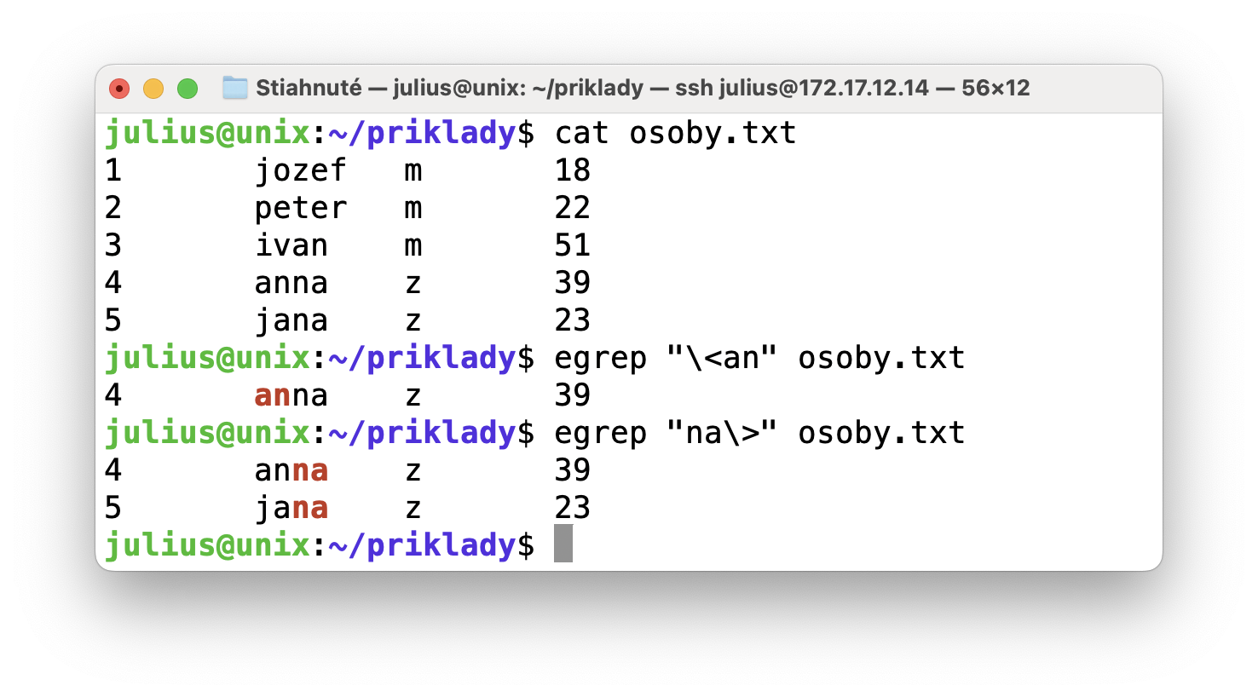
Egrep príklad
grep -Ei "\<an" osoby.txt
grep -Ei "na\>" osoby.txt #aký bude výstup?

Slide 18
Links and Resources
http://www.regular-expressions.info/
RegExr: Learn, Build, & Test RegEx
https://regexr.com/
Questions?

